Slide 1
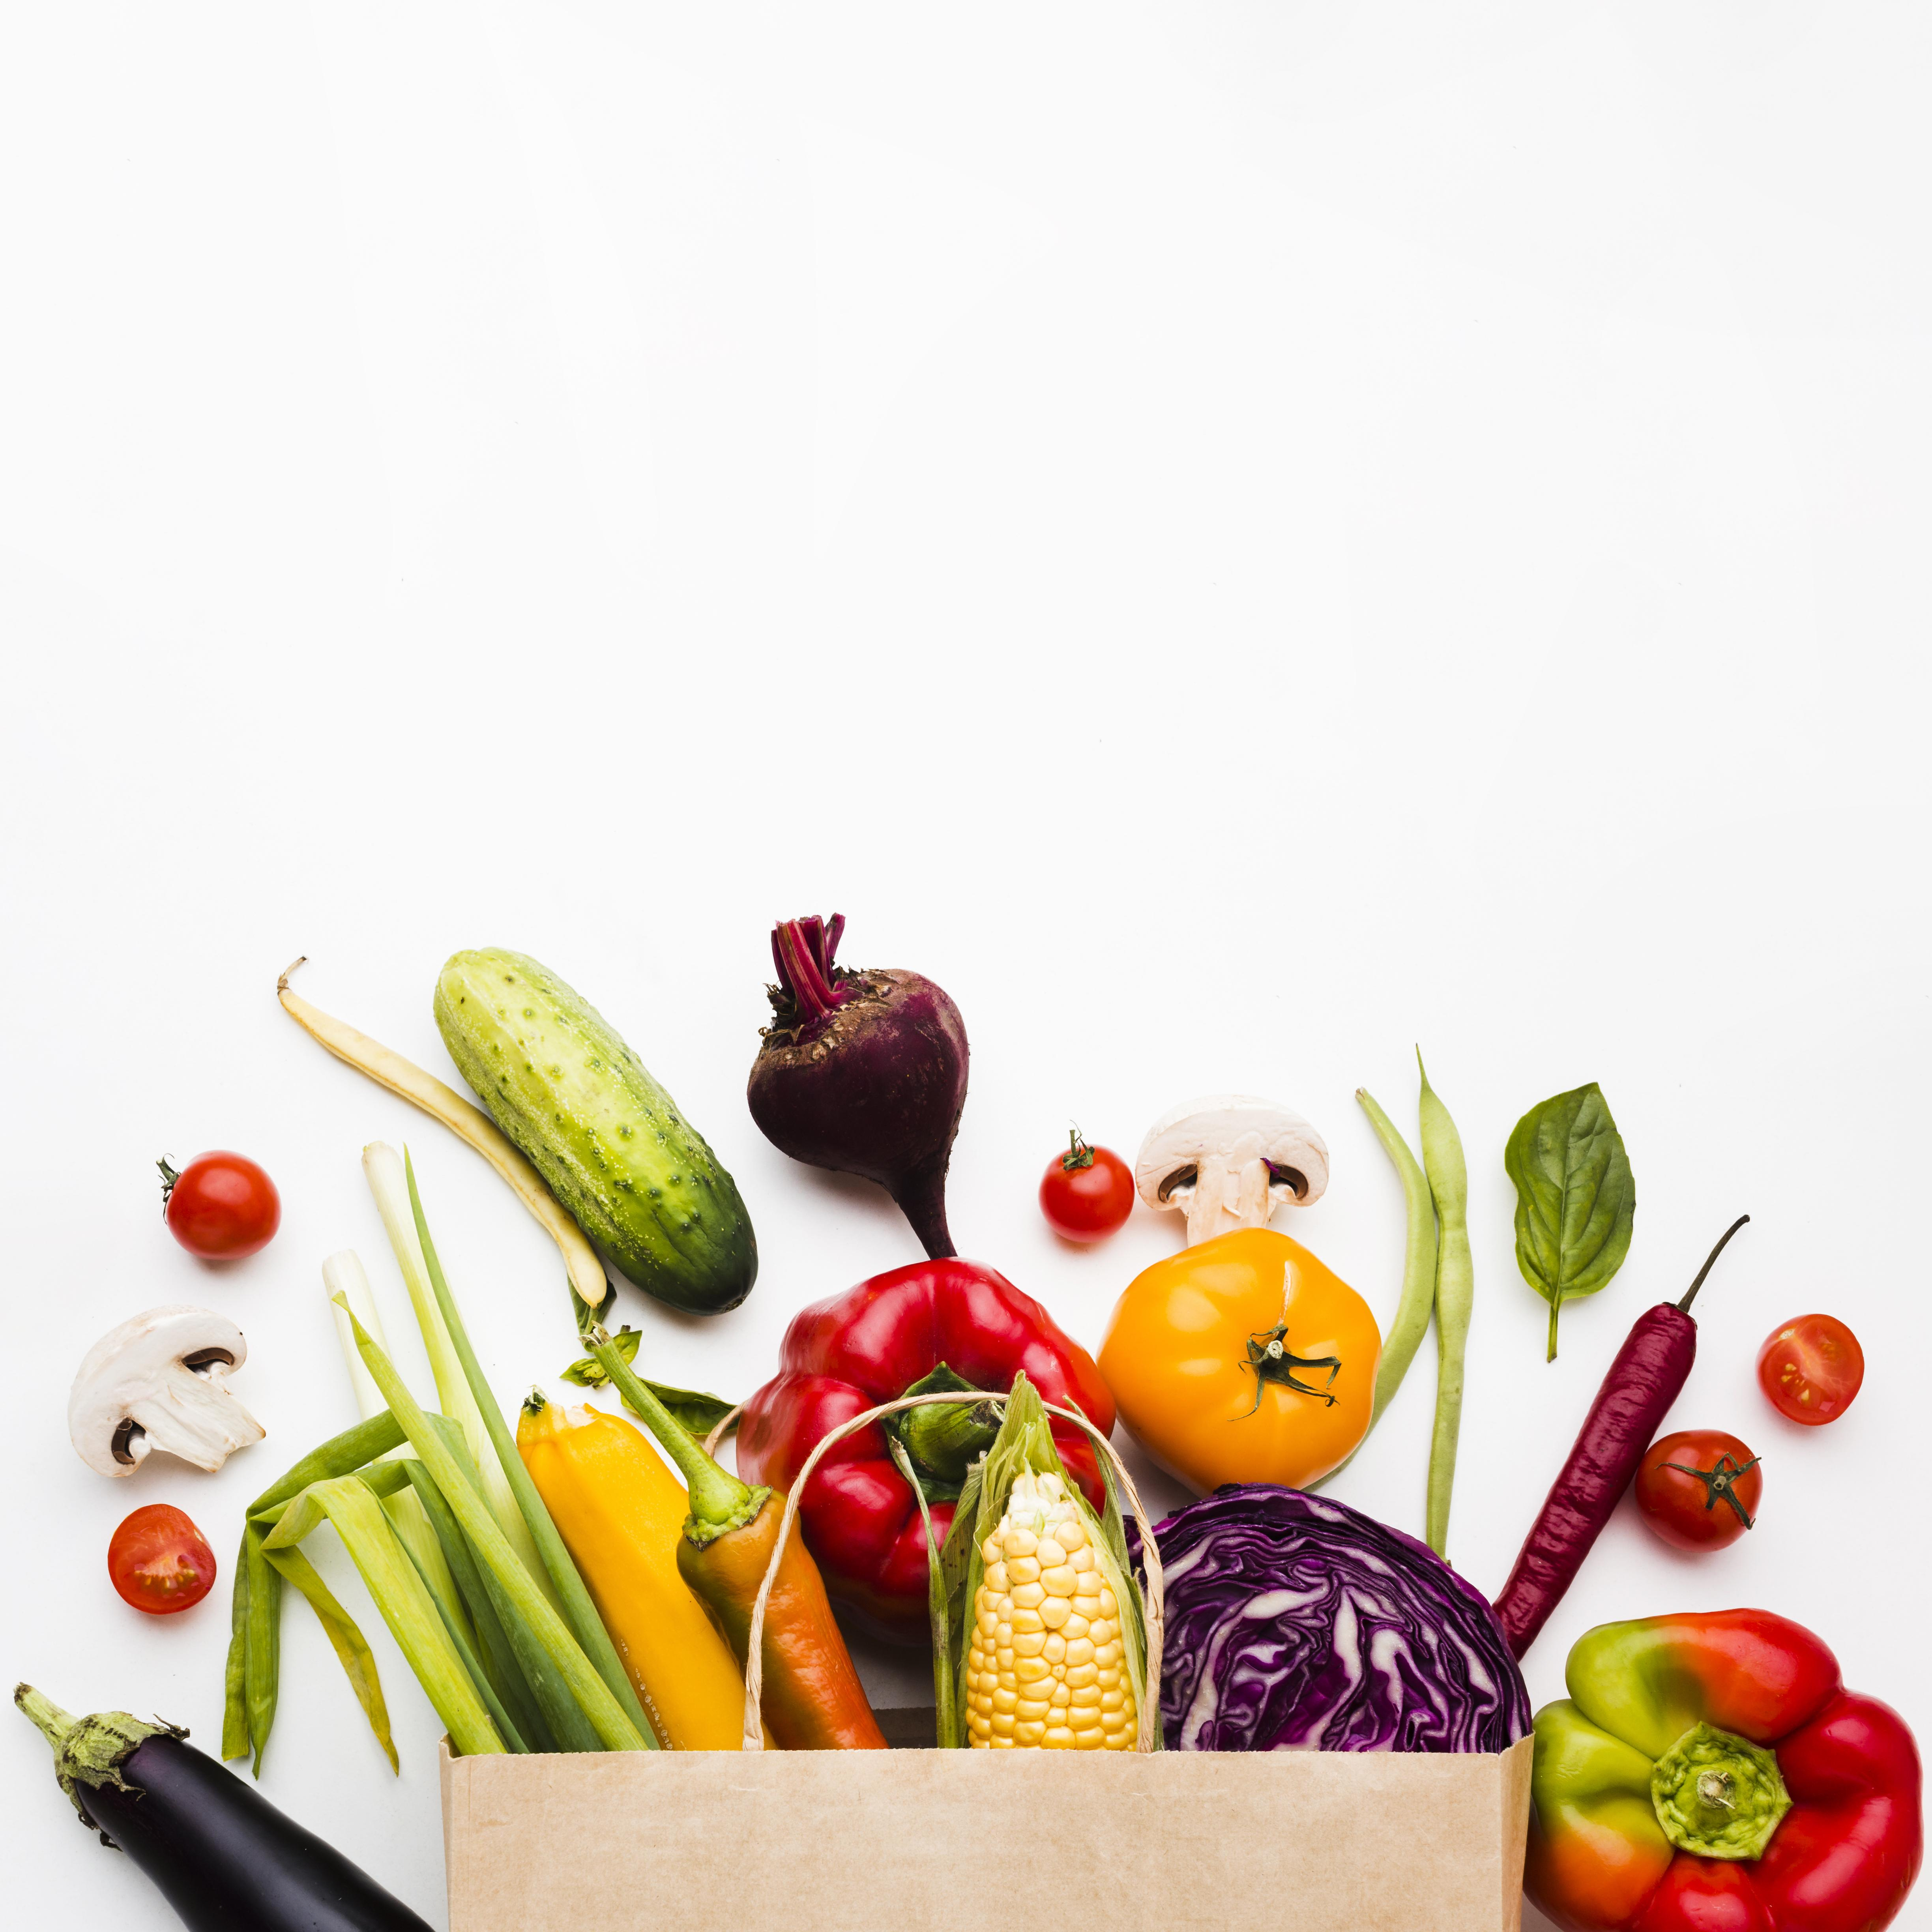
InstaPlatter

Slide 2

INTRODUCTION
Have you ever stared at the ingredients in your kitchen and wondered, 'What can I make with this?' With InstaPlatter, that question becomes a thing of the past. InstaPlatter is your smart cooking companion that turns the ingredients you already have into delicious, easy-to-make recipes in just a few clicks.
By simply inputting what’s available in your fridge, InstaPlatter generates a variety of meal ideas, tailored to your ingredients and dietary preferences. Whether you’re trying to reduce food waste, whip up a quick meal, or discover new recipes, InstaPlatter empowers you to cook creatively, using what you have on hand.
InstaPlatter simplifies the decision-making process in the kitchen, offering personalized recipe suggestions to suit your taste and ingredient availability. No more last minute trips to the grocery store, just great meals, instantly. Welcome to a new era of smart cooking with InstaPlatter!

Slide 3
Team 7
MOHAMMED TAQI AHMED IYAAZ
SAI KIRAN NELLURU
DESHIK YARLAGADDA

Slide 4

PROBLEM STATEMENT
In today’s fast-paced world, many individuals face the challenge of deciding what to cook based on the ingredients they have available. This often leads to food waste, missed opportunities to make creative dishes, or unnecessary grocery trips. With the vast array of recipes online, users may struggle to find relevant options that match their current pantry.
The goal of this project is to develop a system that recommends recipes based on the ingredients a user already has, reducing food waste and simplifying meal preparation. By entering available ingredients, the system will suggest relevant, easy-to-make, and diverse recipe options, providing users with a practical solution for daily cooking challenges.

Slide 5
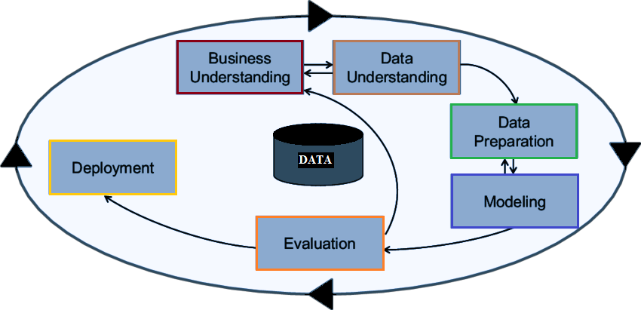
SOLUTION AND IMPLEMENTATION
InstaPlatter follows the CRISP-DM (Cross-Industry Standard Process for Data Mining) methodology, providing a structured framework to ensure a data-driven and efficient recipe recommendation system.
This framework enables efficient project execution by breaking down the process into six key phases.
Business Understanding
Data Understanding
Data Preparation
Modeling
Evaluation
Deployment

Slide 6


1. Business Understanding
Objective: Define the project’s goals clearly. In this case, the main goal is to recommend recipes based on available ingredients.
Key Questions: What type of recipes are most relevant? Are you optimizing for health, taste, speed of preparation, or something else?
2. Data Understanding
Data Sources: Identify and collect data. For the project, the key data sources might include:
Recipe databases.
Ingredient substitutions.
Nutritional values.

Slide 7


3. Data Preparation
Cleaning & Transformation: The data might come in varied formats, i.e. list of ingredients
Normalize ingredient names (example: "tomato" vs. "tomatoes").
Handle missing or ambiguous data (example: handling substitutes).
4. Modeling
Recommendation Algorithms:
Content-Based Filtering: This can be used to suggest recipes based on the ingredients entered. It matches similar recipes based on ingredient overlap.
Natural Language Processing (NLP): If you use recipe text data, NLP could be used to understand and categorize recipe instructions and ingredients.

Slide 8


5. Evaluation
Metrics: Evaluate the model’s performance. For this type of recipe recommendation system, metrics might include:
Accuracy: How well the suggested recipes match the entered ingredients.
User satisfaction: Feedback from users, like ratings or clicks on recipes.
Diversity: How varied the recipe suggestions are (so users don’t get the same recipes repeatedly).
6. Deployment
System Integration: Integrate the recommendation engine into a web application where users input ingredients and receive recipe suggestions.
Real-Time Updates: Optionally, you could update recipes dynamically as more data (like new recipes or user preferences) comes in.

Slide 9
Tools and Technologies
Extract:
APIs: Open Recipe APIs, FoodData Central, Spoonacular, etc.
Web scraping tools: BeautifulSoup, Scrapy.
Transform:
Pandas (for data manipulation), Dask (for larger datasets), PySpark (for distributed data processing).
NLP libraries: NLTK, spaCy for processing text data in recipes.
Load:
Databases: PostgreSQL, MySQL for structured data; MongoDB for unstructured data.
Cloud Solutions: AWS RDS, Google Cloud BigQuery for large-scale data storage.

Slide 10

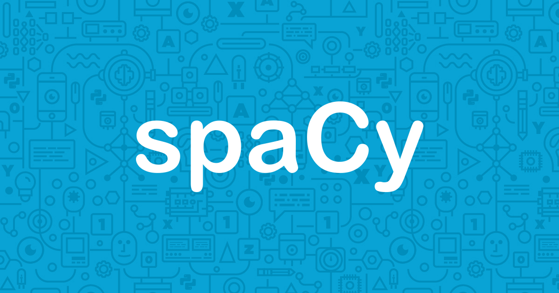

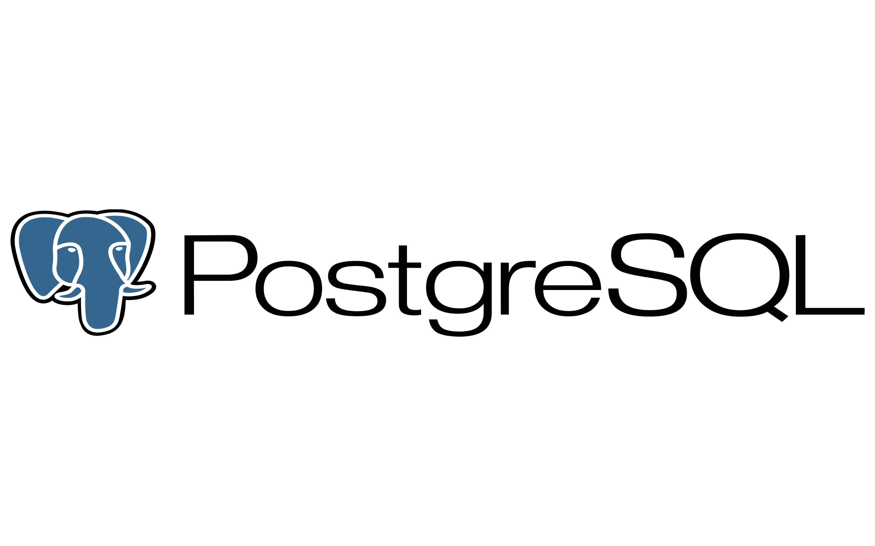





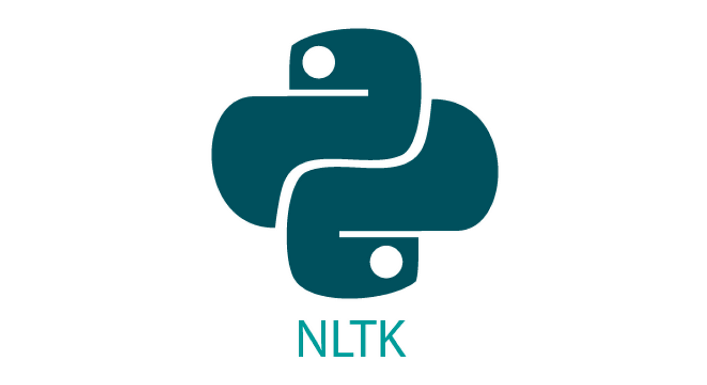
Tools and Technologies

Slide 11
Thank YOU

